Slide 1
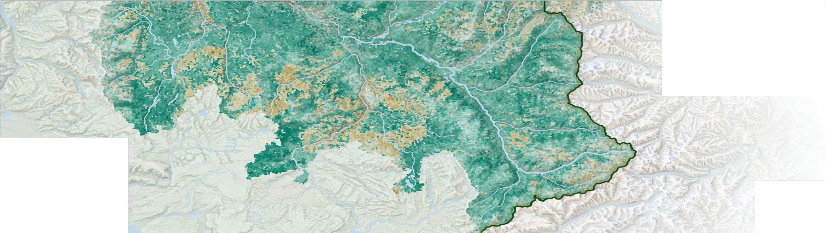


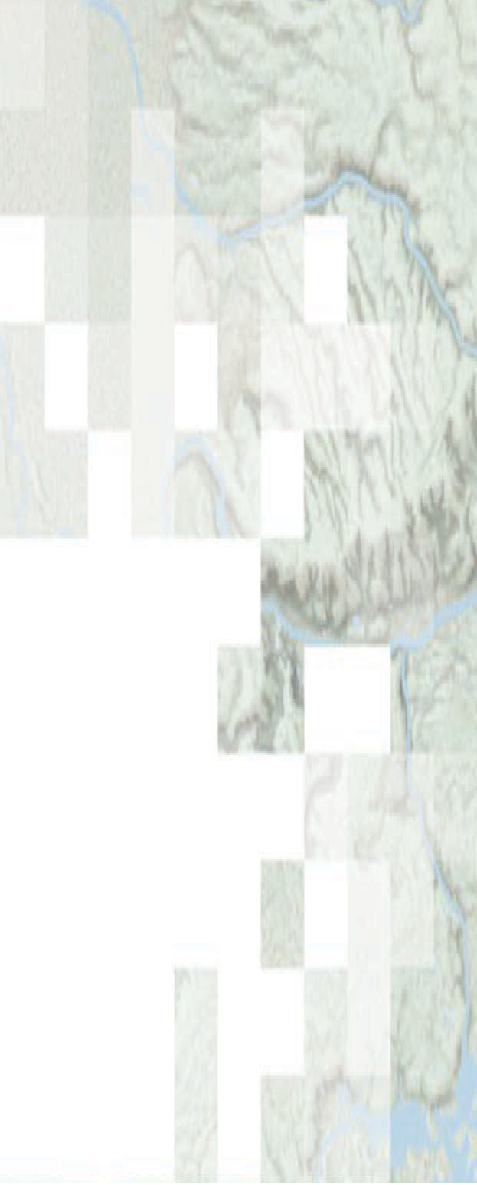


!"#$%&"' )*+%&",#$-. "&/ 01"-* )/2$&$.#+"#$%&
The ITCOocean hack2week content includes slides from NASA ARSET. Slides without the NASA logos were prepared by Eli Holmes (NOAA) and those with the NASA logos are from ARSET.
Species Distribution Modeling with Remote Sensing
Amber McCullum, Juan Torres-Perez, Zach Bengtsson
Aug 12, 2021

Slide 2
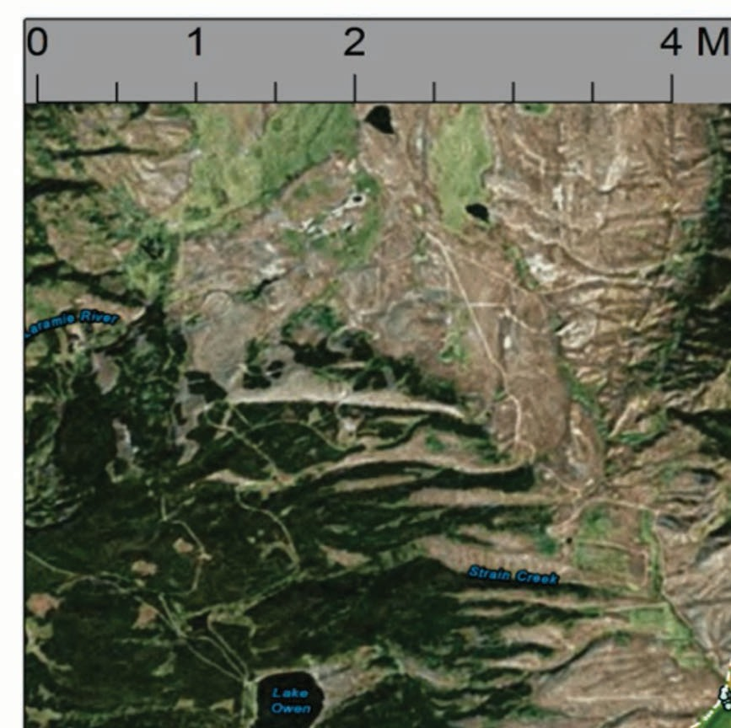
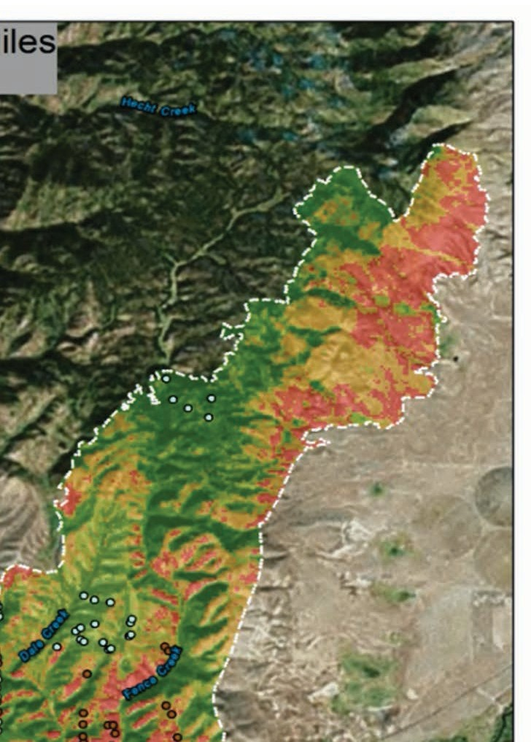
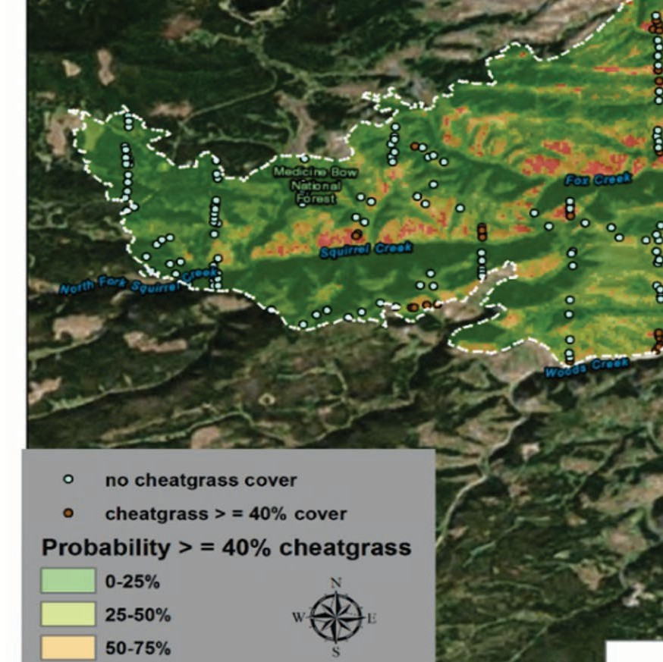
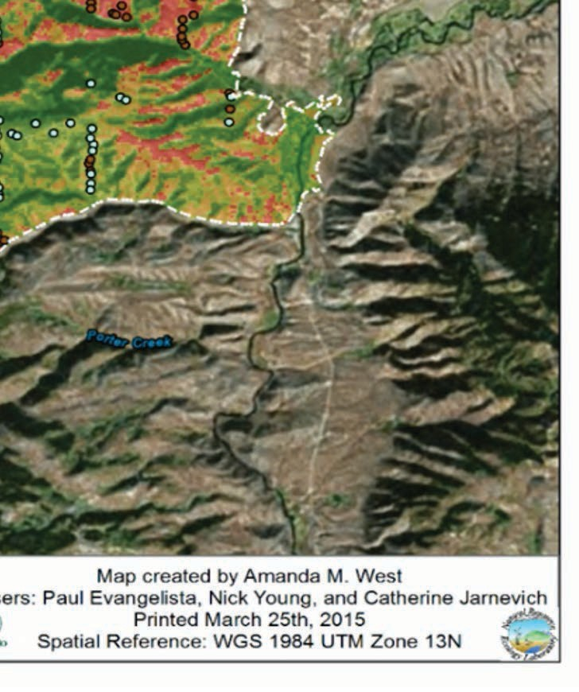
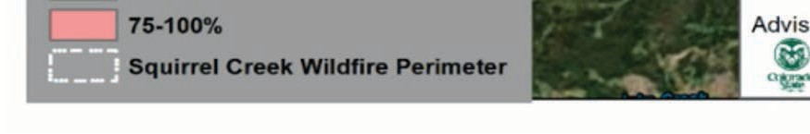
SDM Overview
Week 1 – SDM overview
Species Distribution Models (SDMs) overview
Occurrence data – IndOBIS by Johnny Konjarla
SDM environment data overview
Application lecture by Ben Best
More occurrence data
Week 2 – SDMs in R
Occurrence Data
Environmental Variables
Methods and Models
Case Study Examples
Question and Answer Session
ARSET image
4

Slide 3
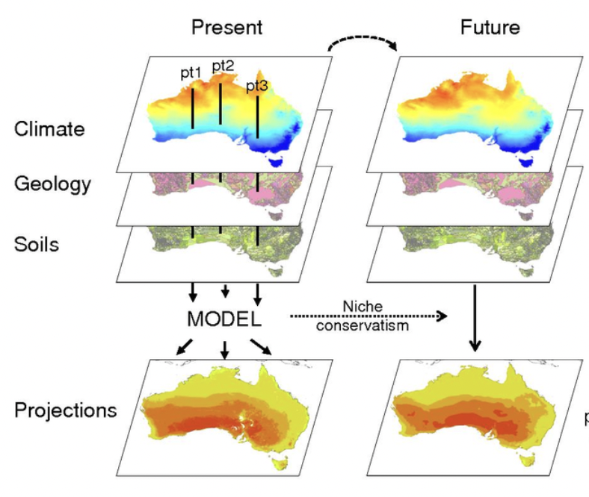
”Species” Modeling
For the techniques we are learning, we are learning “species” does not have to mean species (living organism).
Presence (0/1) observations of something with location and time
Density, count, value observations also work

Slide 4
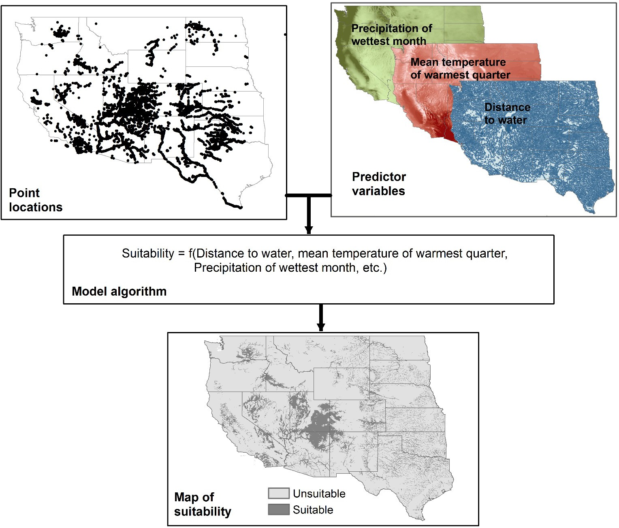
Species Distribution Models (SDMs)
Species Distribution Models allow you to assess the suitability of a habitat for a species.
The models use raster-based layers such as land use/land cover, elevation, and others as predictors of suitable habitats.
The predictor data is combined with ground-collected presence-absence or abundance data in empirical statistical models.
Species Distribution Models: Ecological Explanation and Prediction Across Space and Time
Jane Elith and John R. Leathwick
Annual Review of Ecology, Evolution, and Systematics 2009 40:1, 677-697

Slide 5
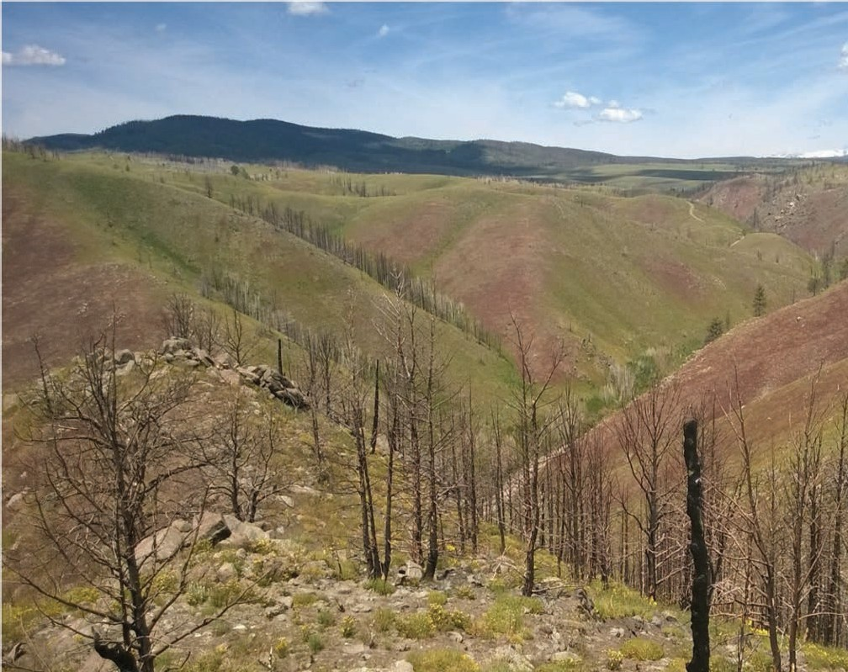
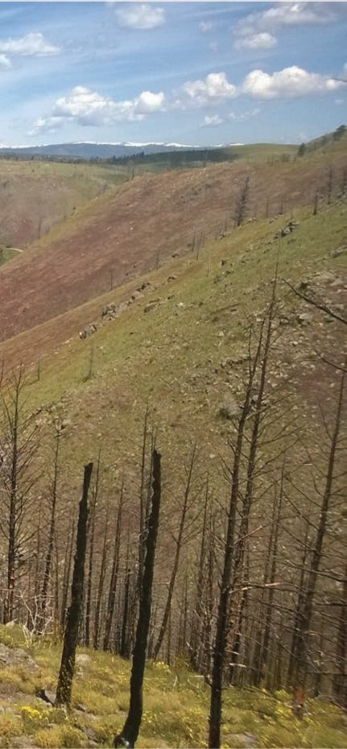
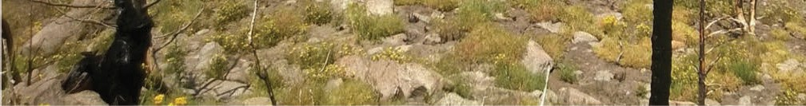
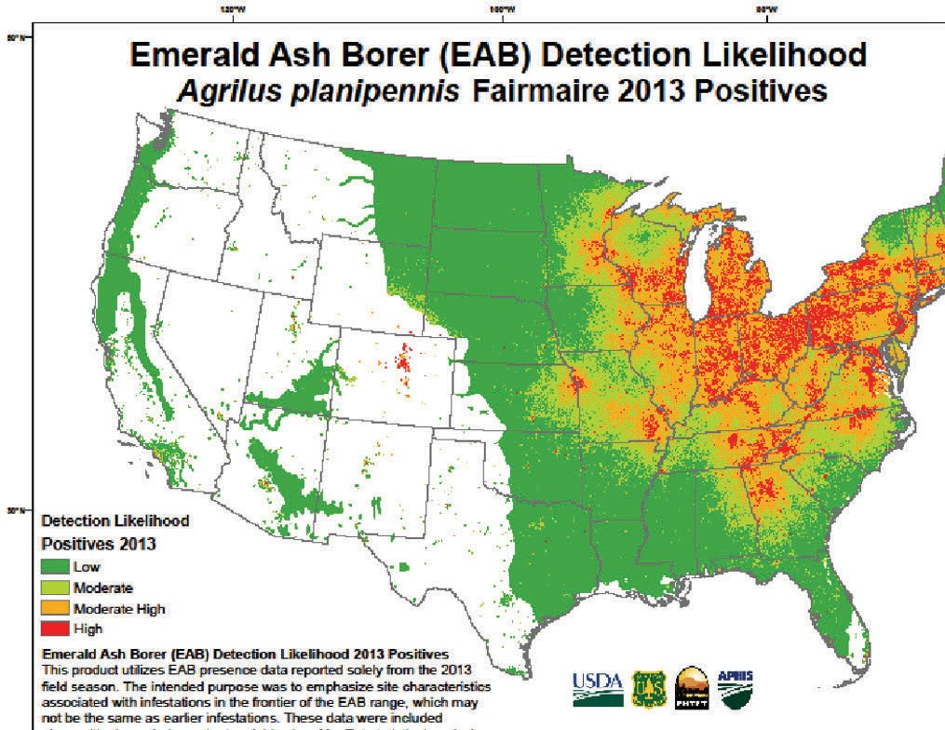
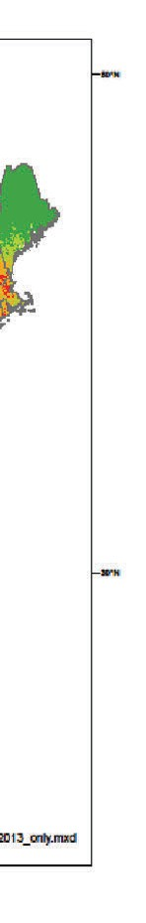
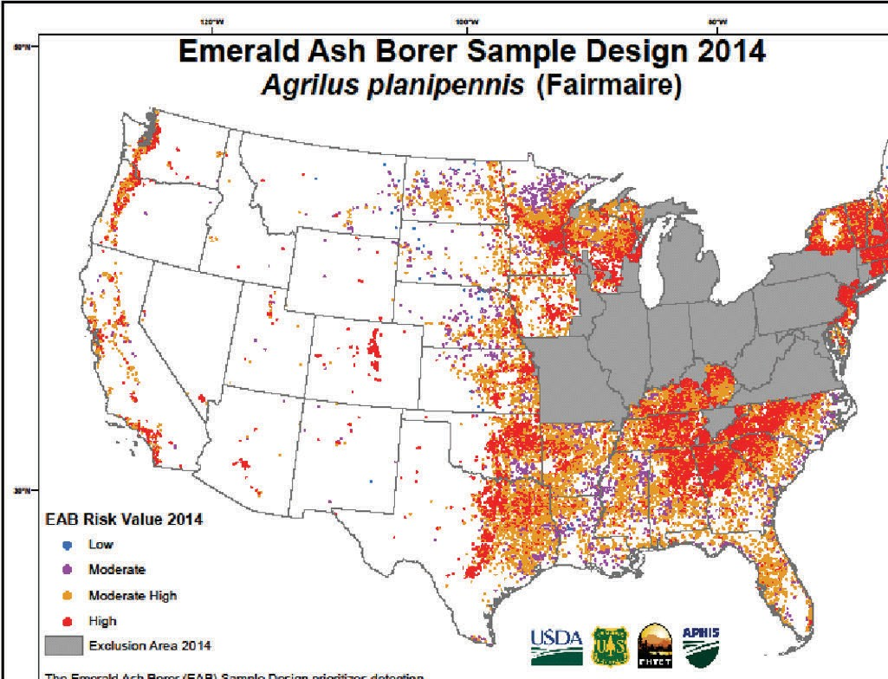
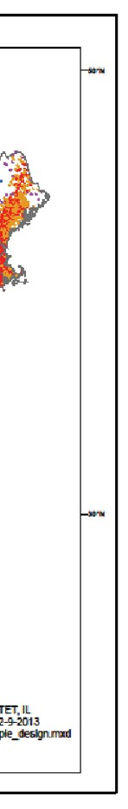
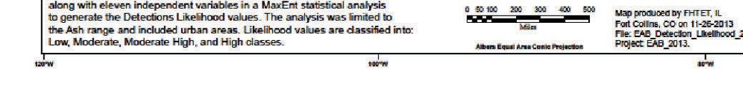
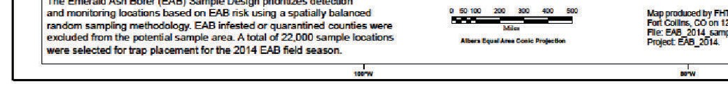
SDM Applications
West et al. 2017, International Journal of Applied Earth Observation and Geoinformation
Invasive species control
Risk assessment
Conservation planning
Monitoring strategies
Scenario modeling under a changing climate
USDA –
model for
EAB

Slide 6
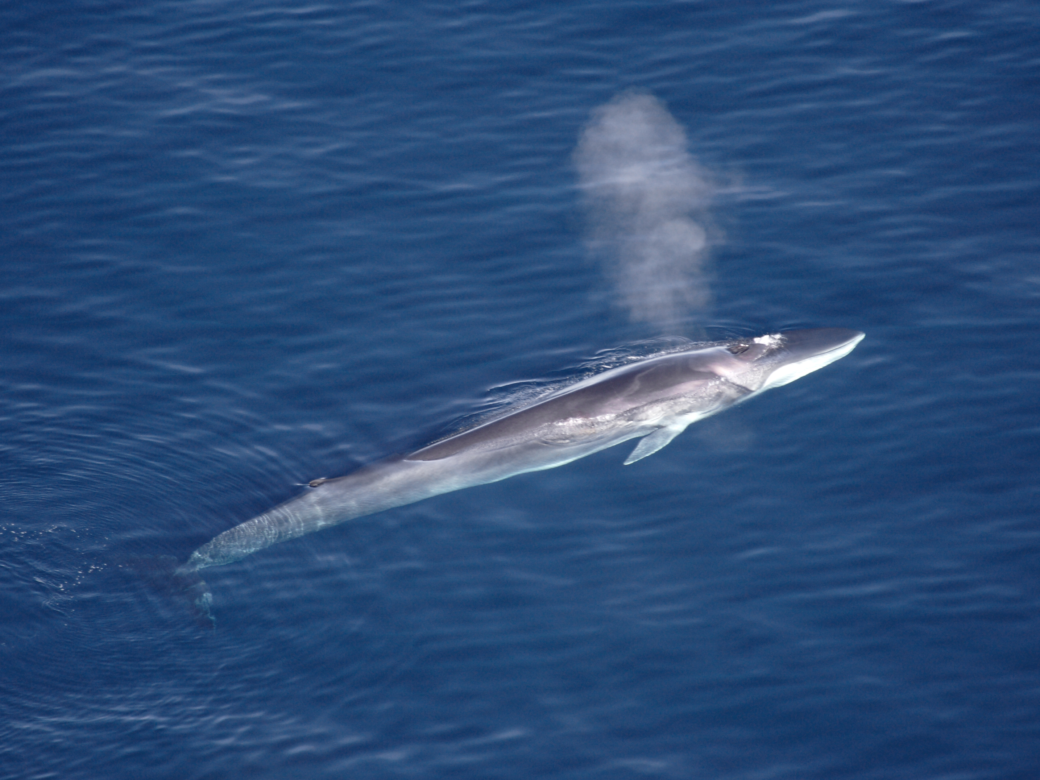
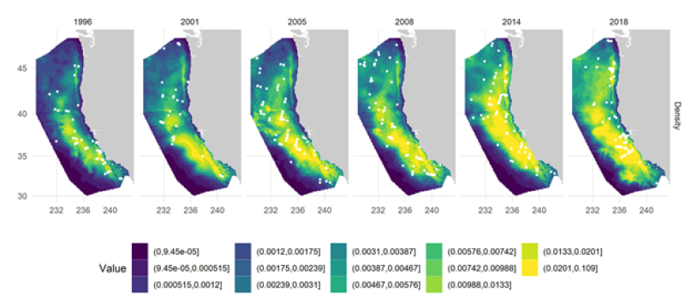
SDM Marine SDMs
NOAA example of SDMs for whale ocean use: https://www.fisheries.noaa.gov/west-coast/science-data/species-distribution-models

Slide 7
SDM Marine SDMs – Why are they used
Marine Conservation Planning: Identifying critical habitats or high use areas or conditions (so you can predict where they will be)
Fisheries Management: Predicting the distribution of commercially important fish species.
Climate Change Impact Assessment: Analyzing how climate change affects marine species' distributions, helping assess their vulnerability and plan for adaptation.
Invasive Species Management: Predicting the potential spread of invasive species in marine environments.
Habitat Restoration: Selecting suitable areas for marine habitat restoration projects, such as seagrass beds or coral reefs.
Marine Spatial Planning: Informing decisions on shipping lanes, fishing zones, tourism areas, and other marine activities
Ecosystem-Based Management: Assessing how changes in one species' distribution may impact the entire marine ecosystem to support holistic management strategies.
Scientific Research: Enhancing our understanding of species ecology, distribution patterns, and habitat preferences in marine environments.

Slide 8
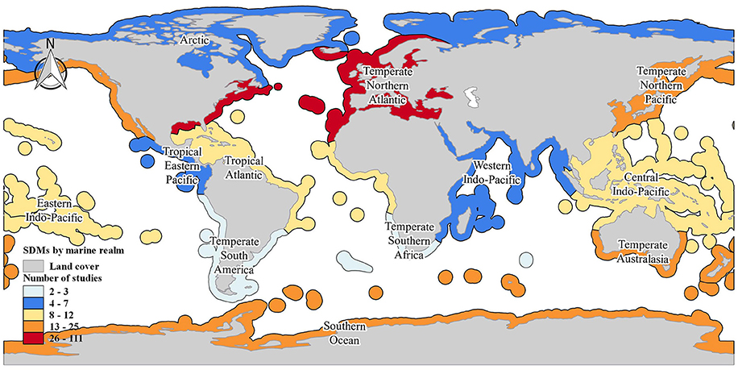
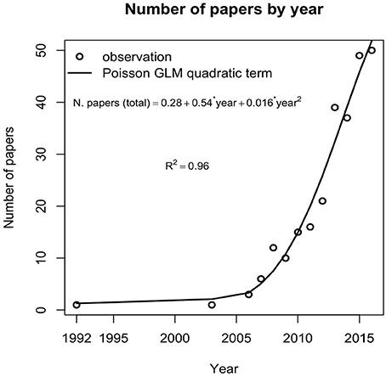
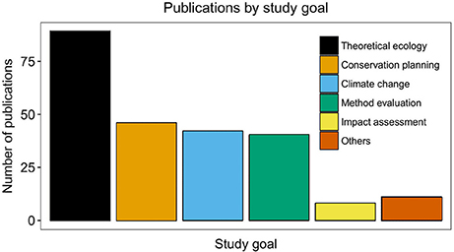
SDM Marine SDMs – Where are they used (2015 data)
Robinson NM, Nelson WA, Costello MJ, Sutherland JE and Lundquist CJ (2017) A Systematic Review of Marine-Based Species Distribution Models (SDMs) with Recommendations for Best Practice. Front. Mar. Sci. 4:421. doi: 10.3389/fmars.2017.00421

Slide 9
SDM Needs and Outputs
Environmental Variables
Characteristics of suitable habitat for a particular species
Occurrence Data
Point locations of species presence
Models/Algorithms
Use of environmental and occurrence data to predict current and/or future species distributions
Output
Habitat suitability (past, current, future)

Slide 10
SDMs…
DO
DO NOT
Identify areas with environmental conditions similar to where a species occurs
Identify where a species is actually found

Slide 11
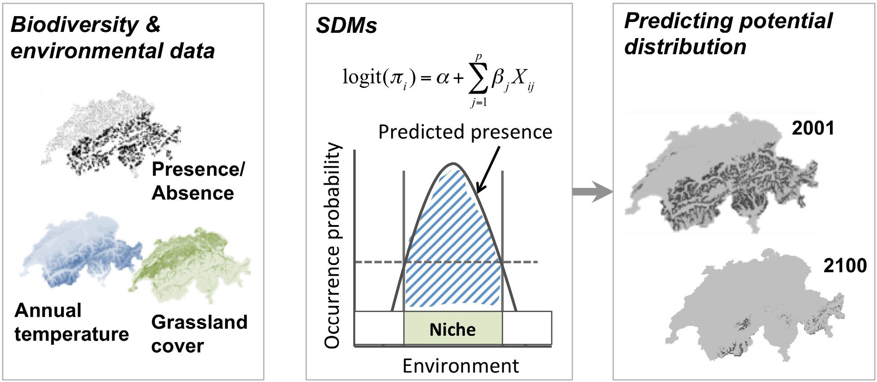
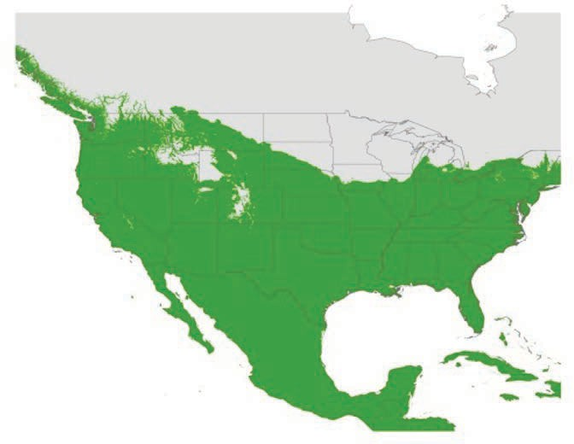
SDM Types
Process-Based
Correlation-Based
Survival
Winter Temperature
SDM in R: Zurell

Slide 12
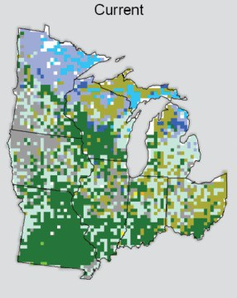
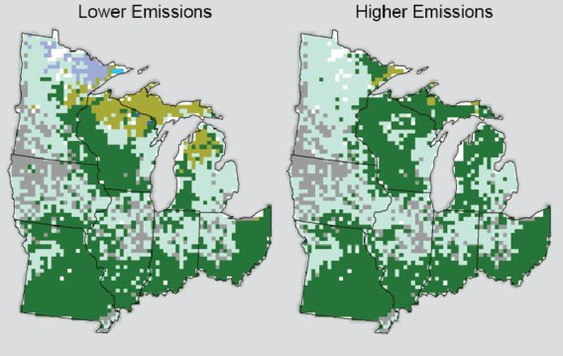
SDM Types
Current – Where is it now?
Mapping
Future – Where might it be?
Potential
Pryor, et al, 2014

Slide 13
Occurrence Data

Slide 14
Environmental Variables

Slide 15
ARSET Contacts for this training content
Trainers:
" Juan Torres-Pérez: juan.l.torresperez@nasa.gov
" Amber McCullum: amberjean.mccullum@nasa.gov
" Zach Bengtsson: bengtsson@baeri.org
Follow us on Twitter @NASAARSET
Training Webpage:
" https://appliedsciences.nasa.gov/join-mission/training/english/arset-species- distribution-modeling-remote-sensing
ARSET Website:
" https://appliedsciences.nasa.gov/what-we-do/capacity-building/arset

